Slide 1

LIBRARY MANAGEMENT
Presented By
Mayuri S. Rawarkar

Slide 2

INTRODUCTION
A Library management system, also known as an automated library system software that has been developed to handle basic housekeeping functions of a library.
It’s a well organized software solution for a Library.
It help to provide information on any book present in library to the user as well as staff member.
It keeps a track of book issue, returned and added to library.

Slide 3
Technologies used.
Spring Boot Framework.
MYSQL.
Angular.
Node JS.
Hibernate.
JPA.

Slide 4

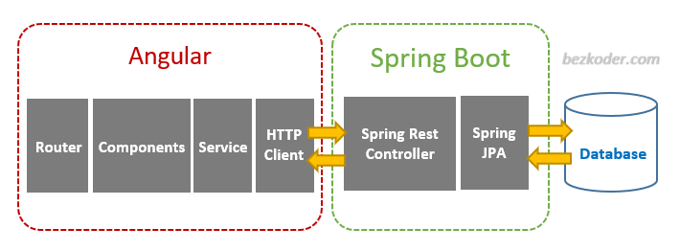
The Architecture of Angular, Spring
& database(MySQL)

Slide 5






The Architecture of the Project

Slide 6
CRUD Operation
Update Record
Delete Record
Insert Record
View Record

Slide 7
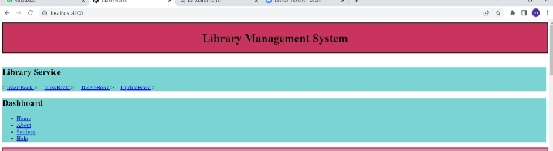
Service Page

Slide 8

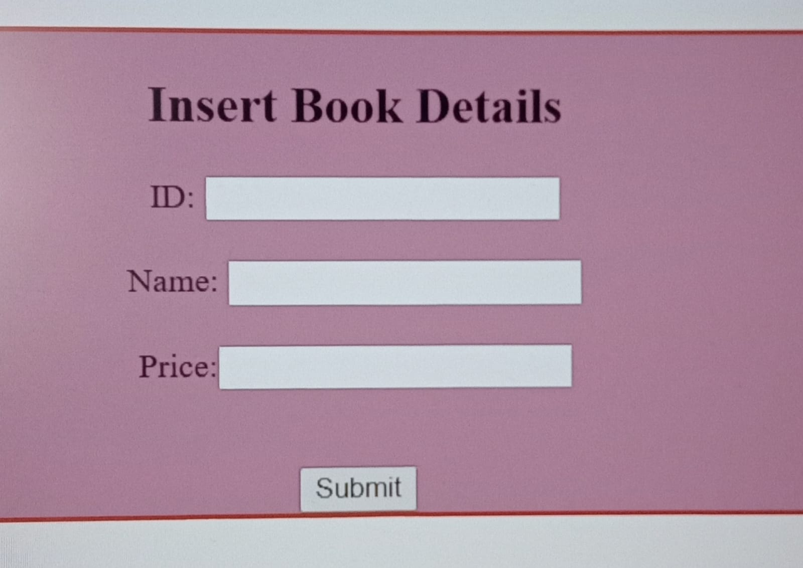

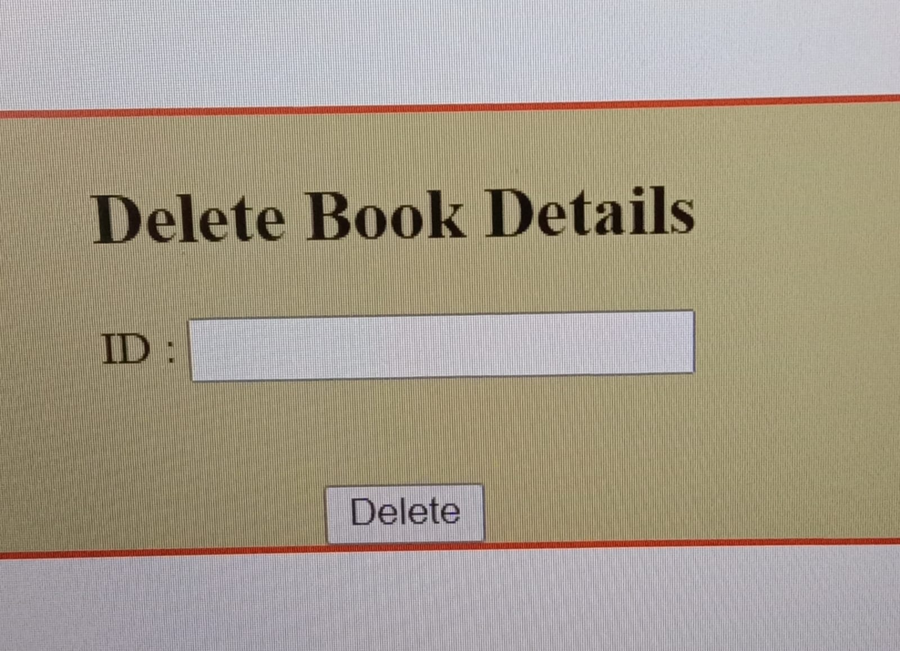
ADD & Delete Record
Add
Delete

Slide 9


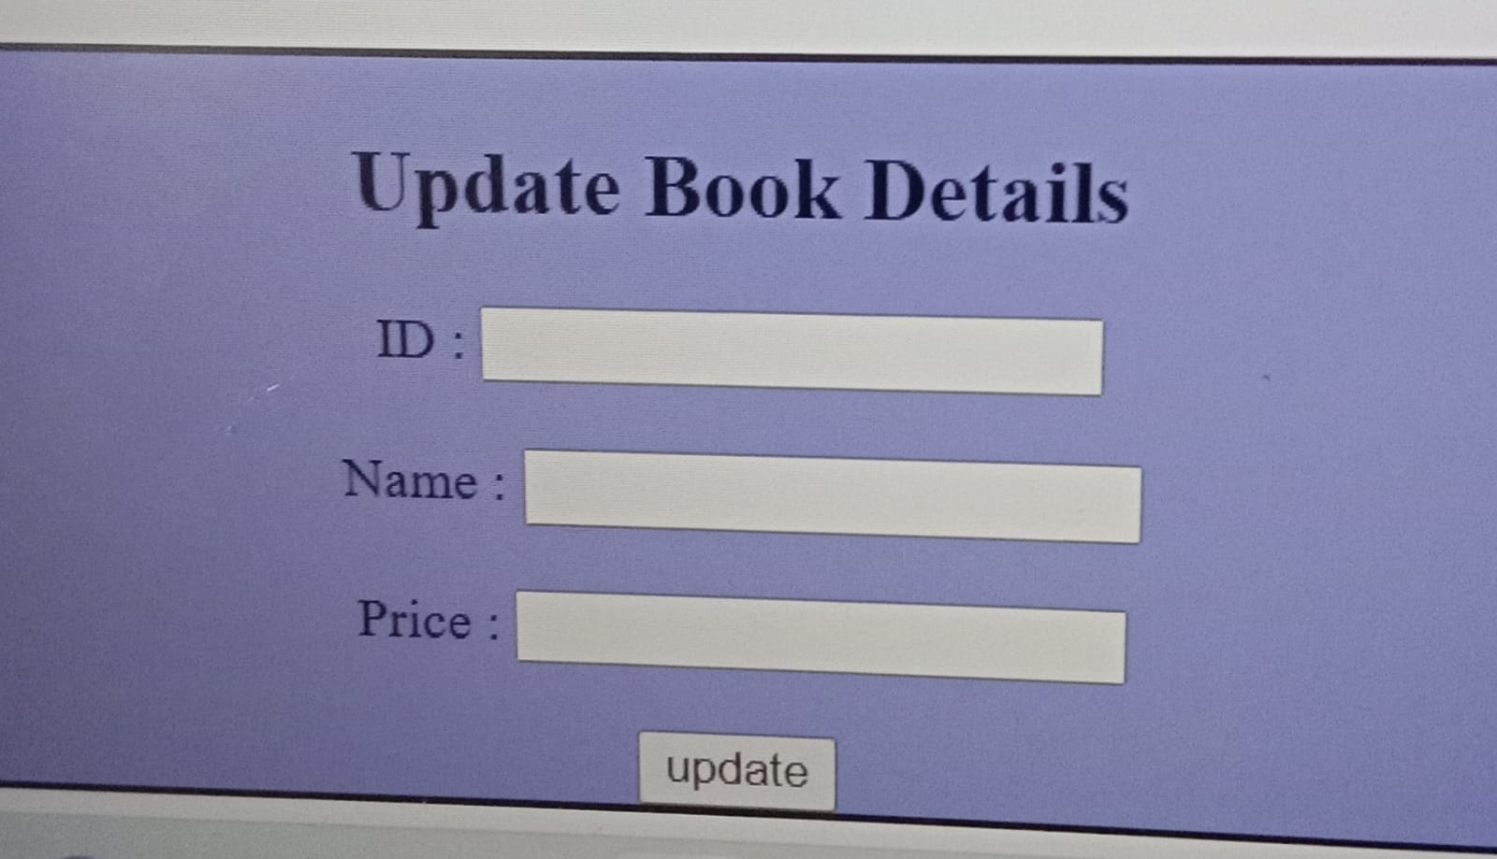
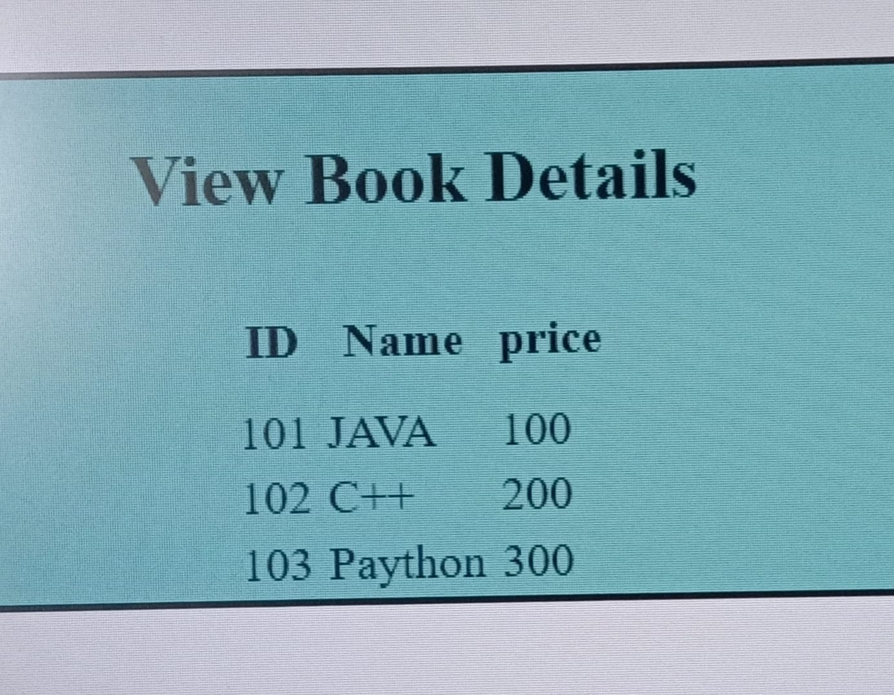
Update & View Record
Update
View

Slide 10
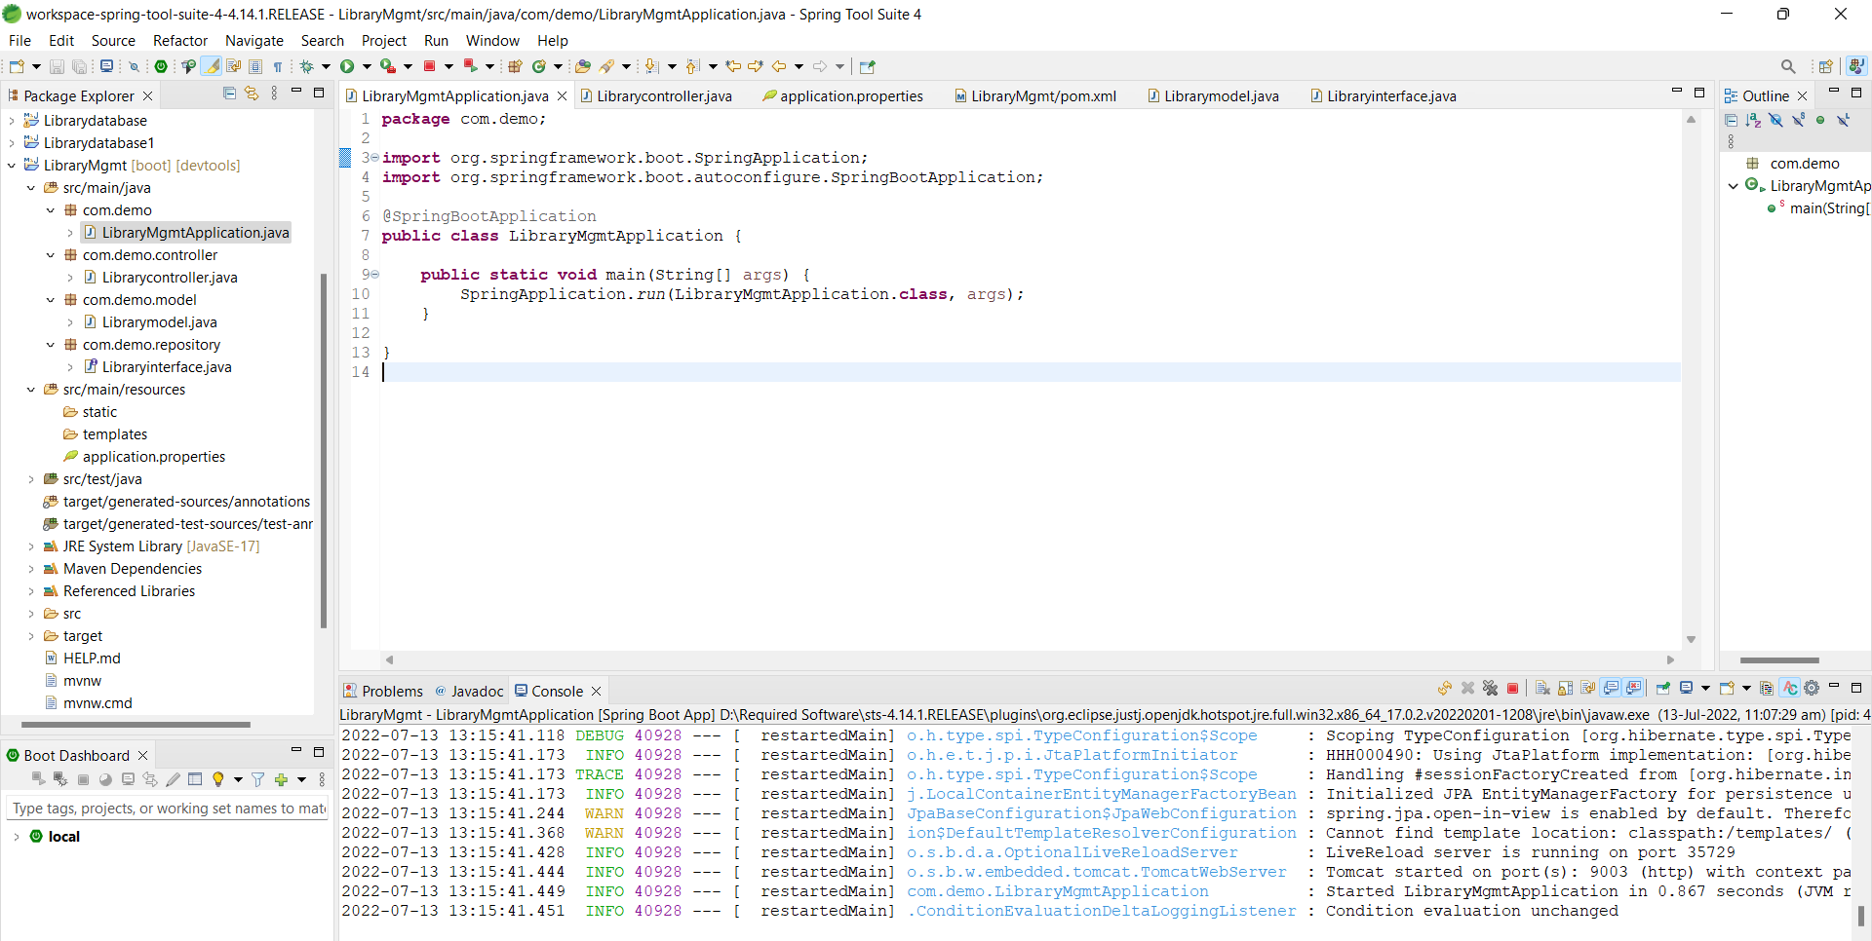
Spring Boot Application

Slide 11
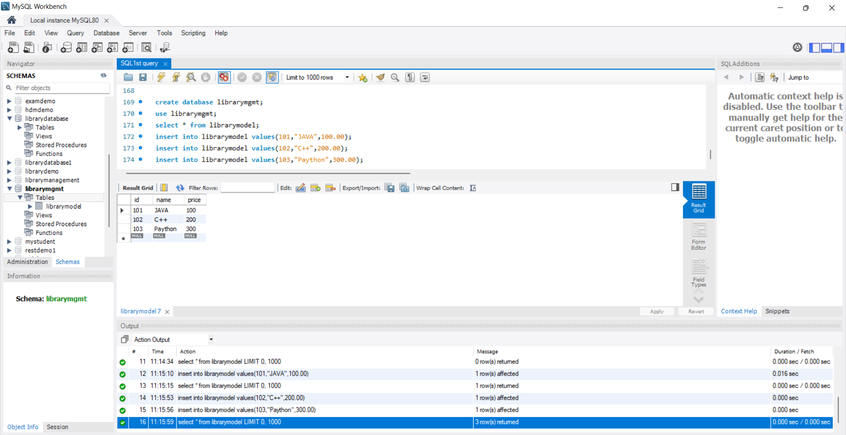
MySQL Code

Slide 12
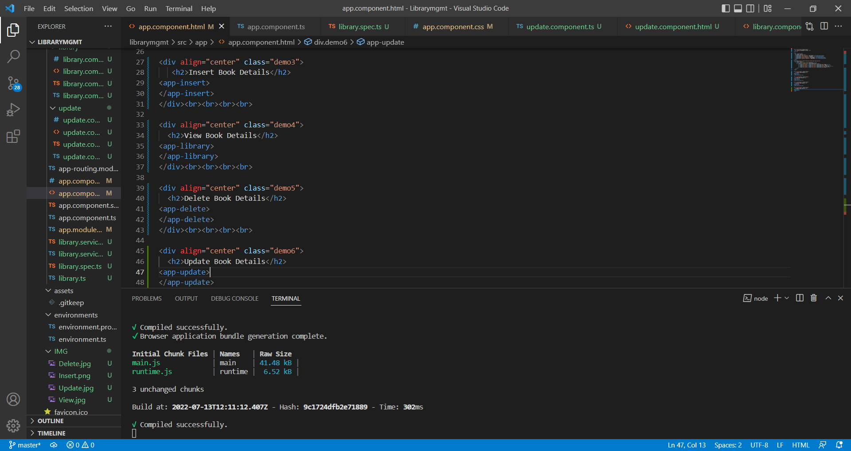
Frontend – Angular JS

Slide 13
Future Scope
The scope of this project is as follows:
To assist the staff in capturing the effort spent on their respective working areas.
To utilize resources in an efficient manner by increasing their productivity through automation.
The system generates types of information that can be used for various purposes.

Slide 14

GitHub Link

Slide 15

THANK YOU.

